Slide 1
Introductory Java and FTC Programming Workshop
Week 2 - Review and GitHub (Nov. 07)
Hanson Chan
Notes:
Hello Everyone! Welcome to my workshop for Introductory Java and FTC Programming. Before I begin, I would like to thank you all for coming, and Esquimalt High School for hosting.

Slide 2
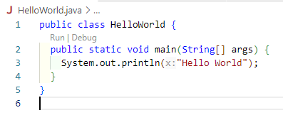
Boilerplate java class

Slide 3
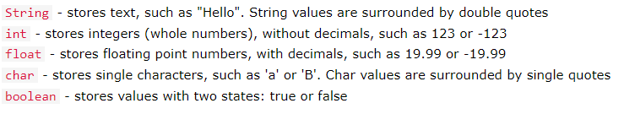
Java Variables

Slide 4
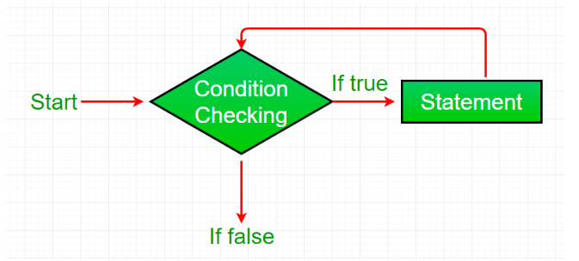
Which loop is this?
Definite loops
For loops
Indefinite loops
While Loops
Do While loops
Notes:
While Loop

Slide 5
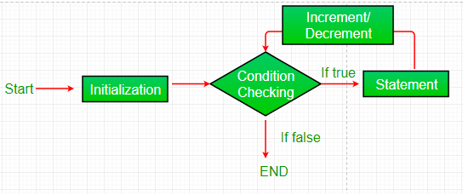
Which loop is this?
Definite loops
For loops
Indefinite loops
While Loops
Do While loops
Notes:
For loop

Slide 6
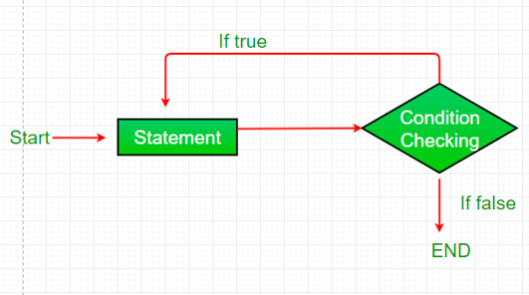
Which loop is this?
Definite loops
For loops
Indefinite loops
While Loops
Do While loops
Notes:
Do While Loop

